Slide 1
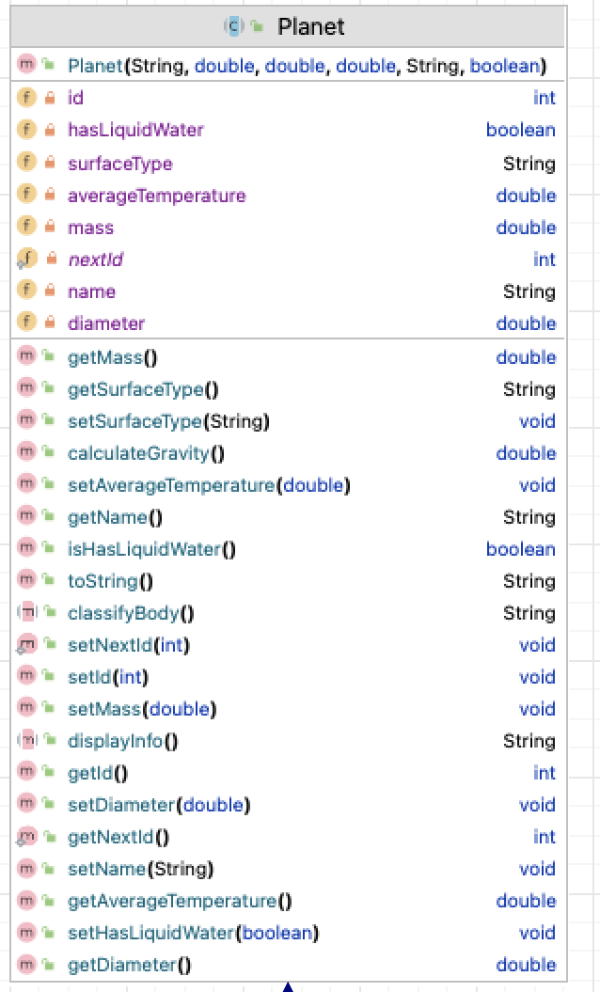
Class Name
Instance Fields
Constructor
Instance fields – data types
Methods
methods– return types

Slide 2
